Slide 1
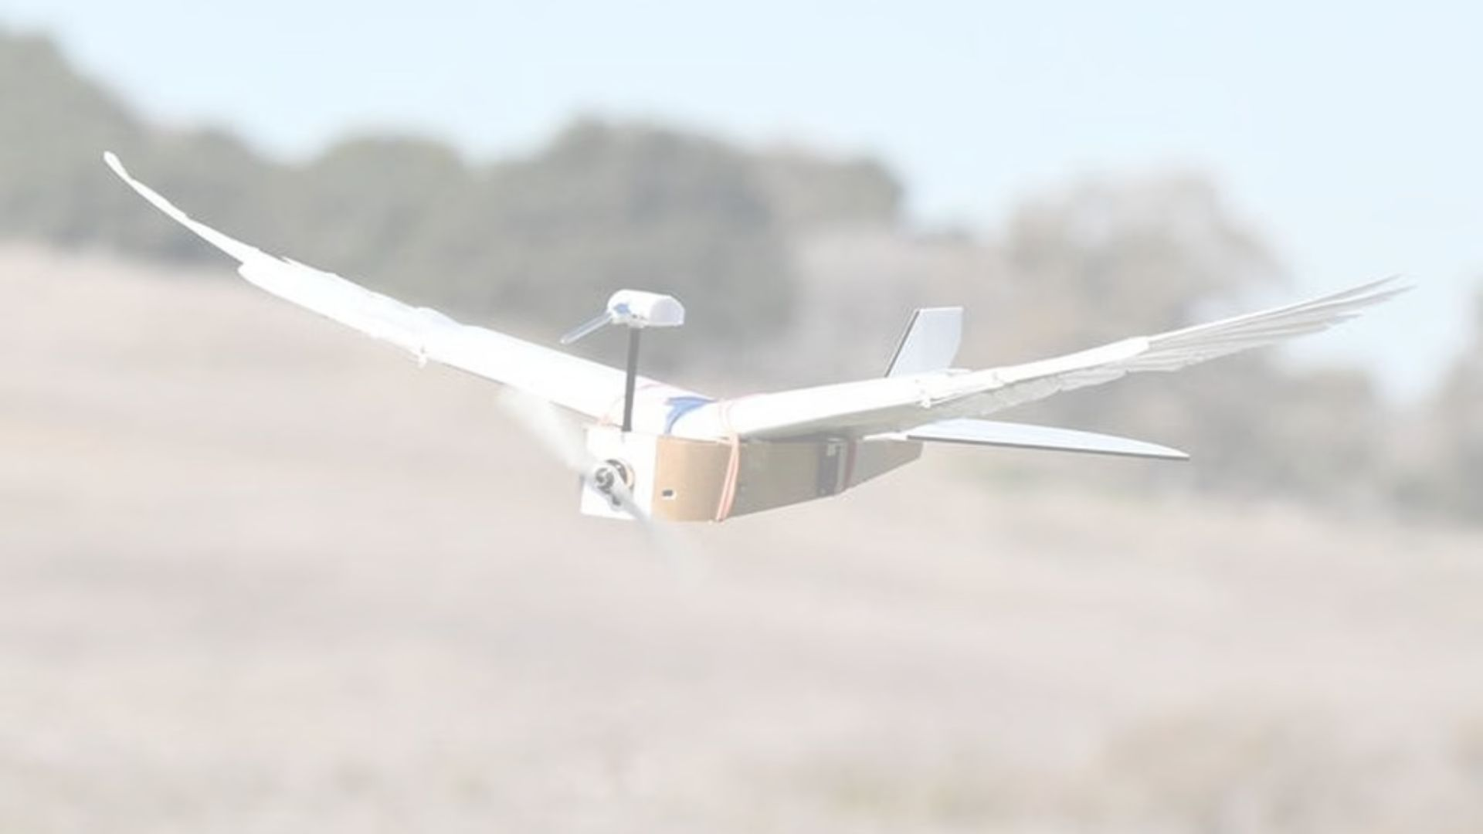
GE107 PROJECT
BIRD DRONE

Slide 2
TARGET PROBLEM
There have been many advancements in the development of conventional drones that are somewhat mini helicopters with rigid wings and propellers. But in spite of numerous advancements, there are still many problems associated with these type of drones such as:
Battery life of conventional drones is less which limit their flight time and range.
Due to rigid wings, the movement of conventional drones is restricted in small places
Conventional drones are easily noticeable in spy activities and also disturb wildlife while recording them

Slide 3
SOLUTION
The described shortcomings of the conventional drones can be easily resolved by the BIRD DRONE.
The flapping of the bird drone powers it and hence increases the flight time and range of the drone.
The flexible wings of the bird drone makes it more suitable to fly in small places.
The bird drone can be easily camouflaged and hence a great technology for spying activities and recording wildlife without disturbing them.

Slide 4
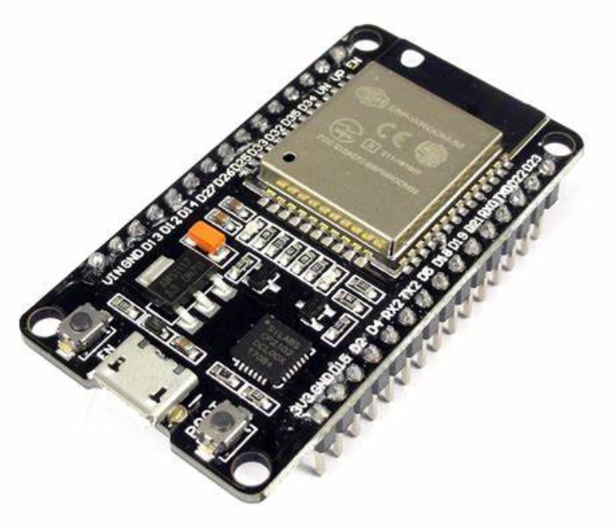
COMPONENTS REQUIRED
ESP WROOM 32 S module is a type of powerful microcontroller with built-in Wi-Fi and Bluetooth capabilities. We have used the bluetooth wireless communication with the smart phone as host.
ESP32 is a popular combination used in a wide range of applications, from home automation to surveillance systems.

Slide 5
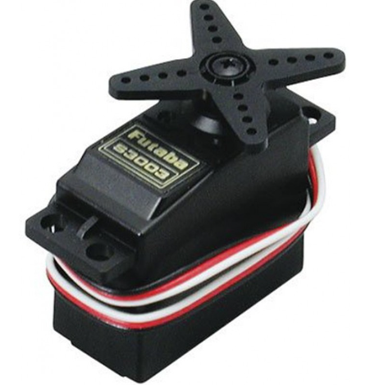
Servo motor :
A servo motor is a type of rotary actuator that is commonly used in industrial and robotic applications. It consists of a motor, a feedback device, and a controller, which work together to precisely control the position, speed, and torque of the motor.
The motor is controlled by the ESP Wroom 32S module and powered by Li-Po Battery.
The motor is used in requirement of high torque applications.

Slide 6
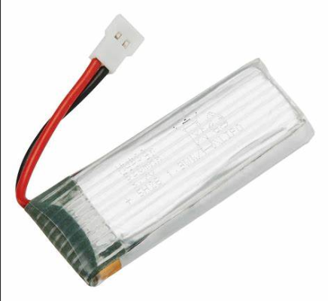
Lipo battery :
LiPo (Lithium Polymer) batteries are a type of rechargeable battery commonly used in portable electronic devices such as smartphones, tablets, and RC vehicles. They are known for their high energy density, light weight, and ability to deliver high currents.

Slide 7
Implementation
First mechanical assembling of the bird drone is done by making wings and bird body and wings with some light weight material. Electrical components of the drone includes ESP32 module, two high torque servo motor,and battery, etc.
The ESP32 plays the role of the micro controller in the electrical circuit. ESP32 is programmed using language like Arduino which control the movement, understand the sensor data and communicate with the controller wirelessly.
ESP32 controls the flapping movement of the wings which is powered by a high rpm core-less motor. It rotate the wing joints to move the wings up and down, generating the lift needed for flight.

Slide 8
Implementation
Servo motors are used to maintain the angle of tail flap hence allowing the bird to turn, ascend and descend. The ESP32 work both ways of radio transmission and Bluetooth control. Here we will be using the Bluetooth communication to use our mobile phone as a controller for the drone. We will be using Lipo batteries to power the motors and ESP32 mounted on the bird. ESP32 receives information about the direction of movement and angle of wings which is communicated to the controller via Bluetooth connection with our smart phone which therefore gives the command to maintain stable flight and control the drone.

Slide 9
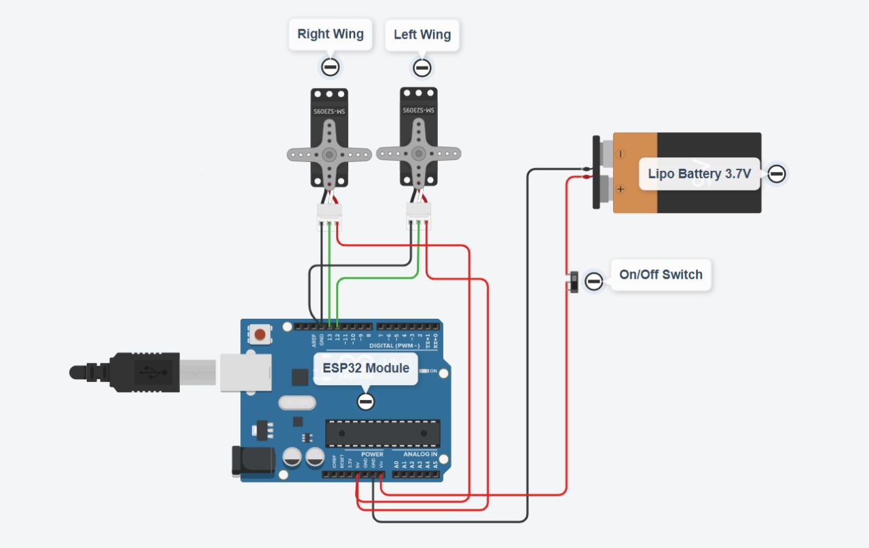
CIRCUIT DIAGRAM

Slide 10
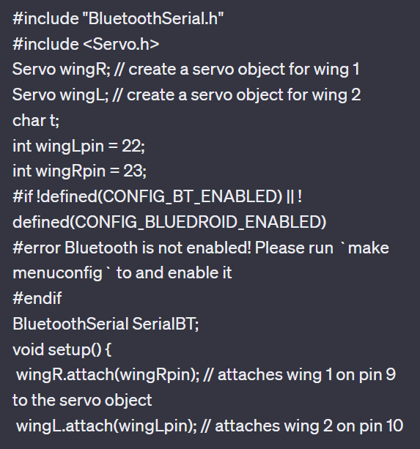
Code description
Bluetooth serial library is added to establish a wireless communication between microcontroller and operating device, i.e. smart phone.
Servo library is added to control the movements of two servo motors.
Two servo objects wingL and wingR are defined analogous to the wings of bird.
If the signal from the bluetooth is available, it is tested with the predefined cases of movement which calls the respective function for that particular movement.

Slide 11
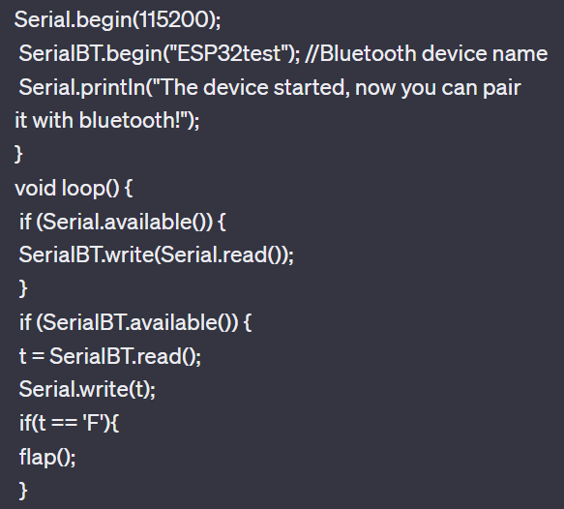
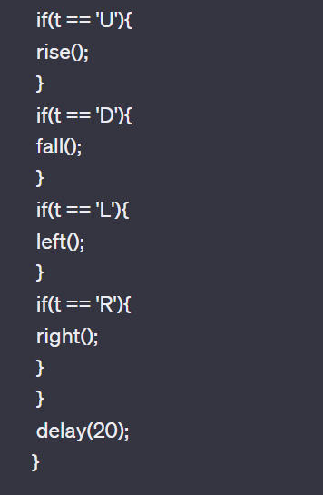

Slide 12
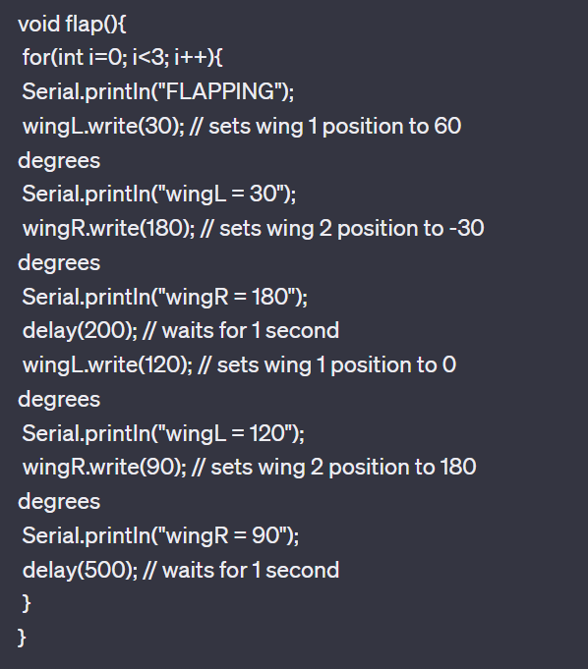
Code for bluetooth connection:-
For Example: If “F” is the received signal, it calls the function flap.
Flap function sets the left and right wing at 30° and 180° w.r.t. Motor’s axis.
After delay of 1 second, it again sets the left wing at 120° and right wing at 90° w.r.t. Motor’s axis.

Slide 13
INNOVATIONS & FUTURE ADVANCEMENTS :
Some potential future advancements of bird drones:
1. Improved flight performance: One of the key areas of innovation for bird drones is in their flight performance. Developers are working to create drones that can fly longer distances, at higher altitudes, and in more challenging weather conditions. 2. Autonomous flight: Another area of advancement is in autonomous flight capabilities. Bird drones are being equipped with sensors and software that allow them to fly autonomously, making them more efficient and reducing the need for human operators. 3. Miniaturization: Miniaturization is an important area of innovation for bird drones. Developers are working to create smaller and lighter drones that can be launched and operated from a variety of locations.

Slide 14
INNOVATIONS & FUTURE ADVANCEMENTS :
4. Integration with other technologies: Bird drones are being integrated with other technologies, such as artificial intelligence and machine learning, to enhance their capabilities. This allows them to perform more complex tasks and to collect and analyze data more effectively. 5. Improved sensors: Bird drones are being equipped with improved sensors, such as high-resolution cameras, thermal imaging sensors, and lidar sensors. These sensors allow them to capture more detailed and accurate data, which can be used for a variety of applications. 6. Environmental monitoring: One of the most promising applications for bird drones is in environmental monitoring. Bird drones can be used to monitor wildlife populations, track migratory patterns, and assess the health of ecosystems.

Slide 15
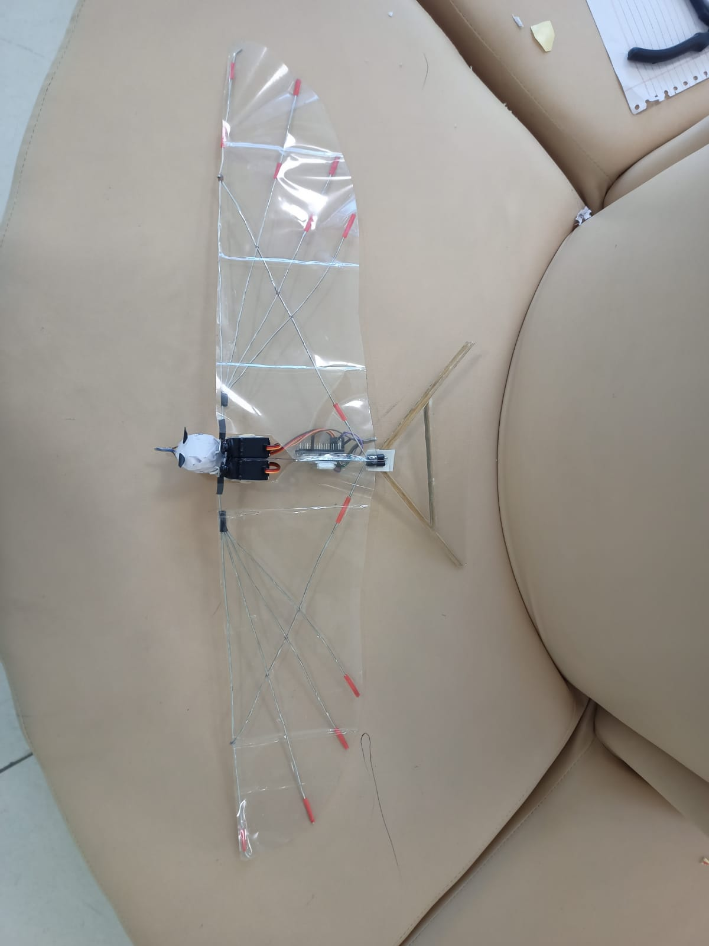
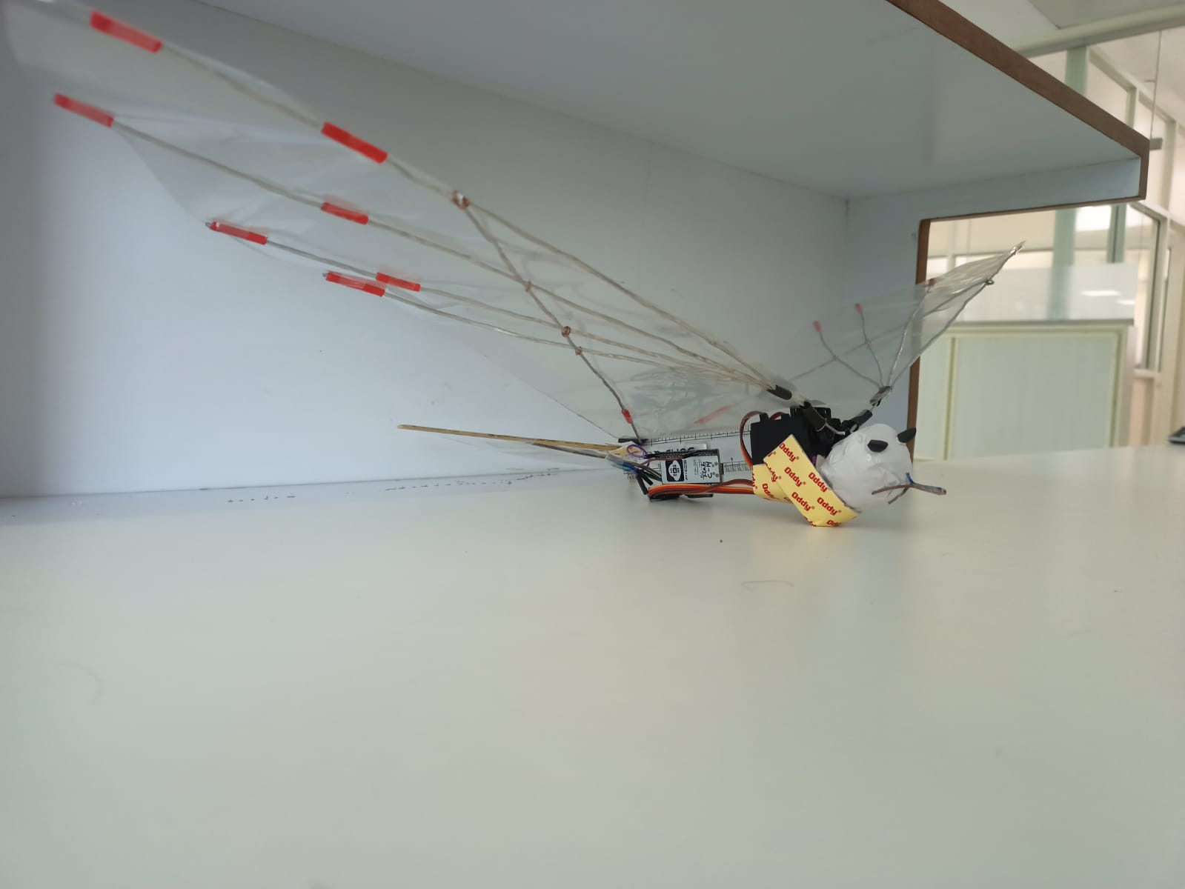
Project Images:-

Slide 16
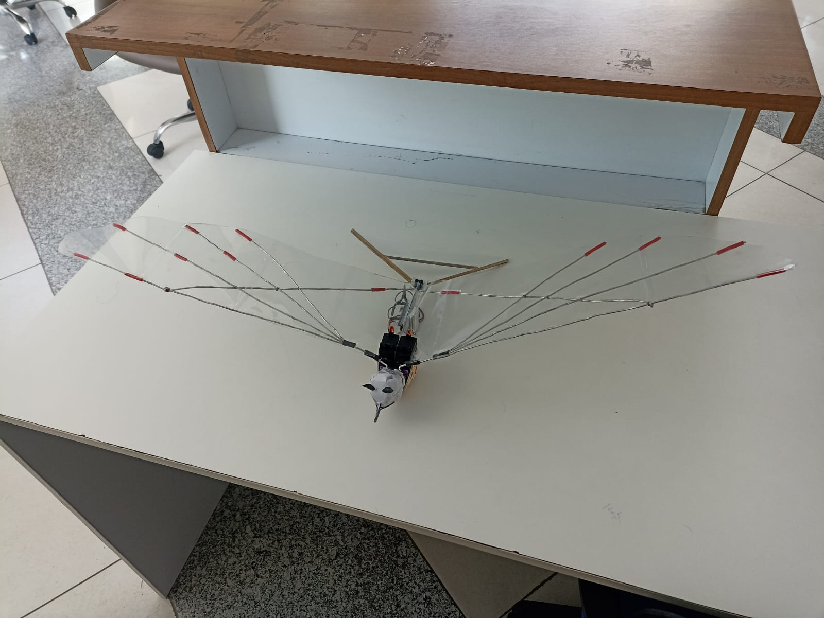
Project Images:-

Slide 17
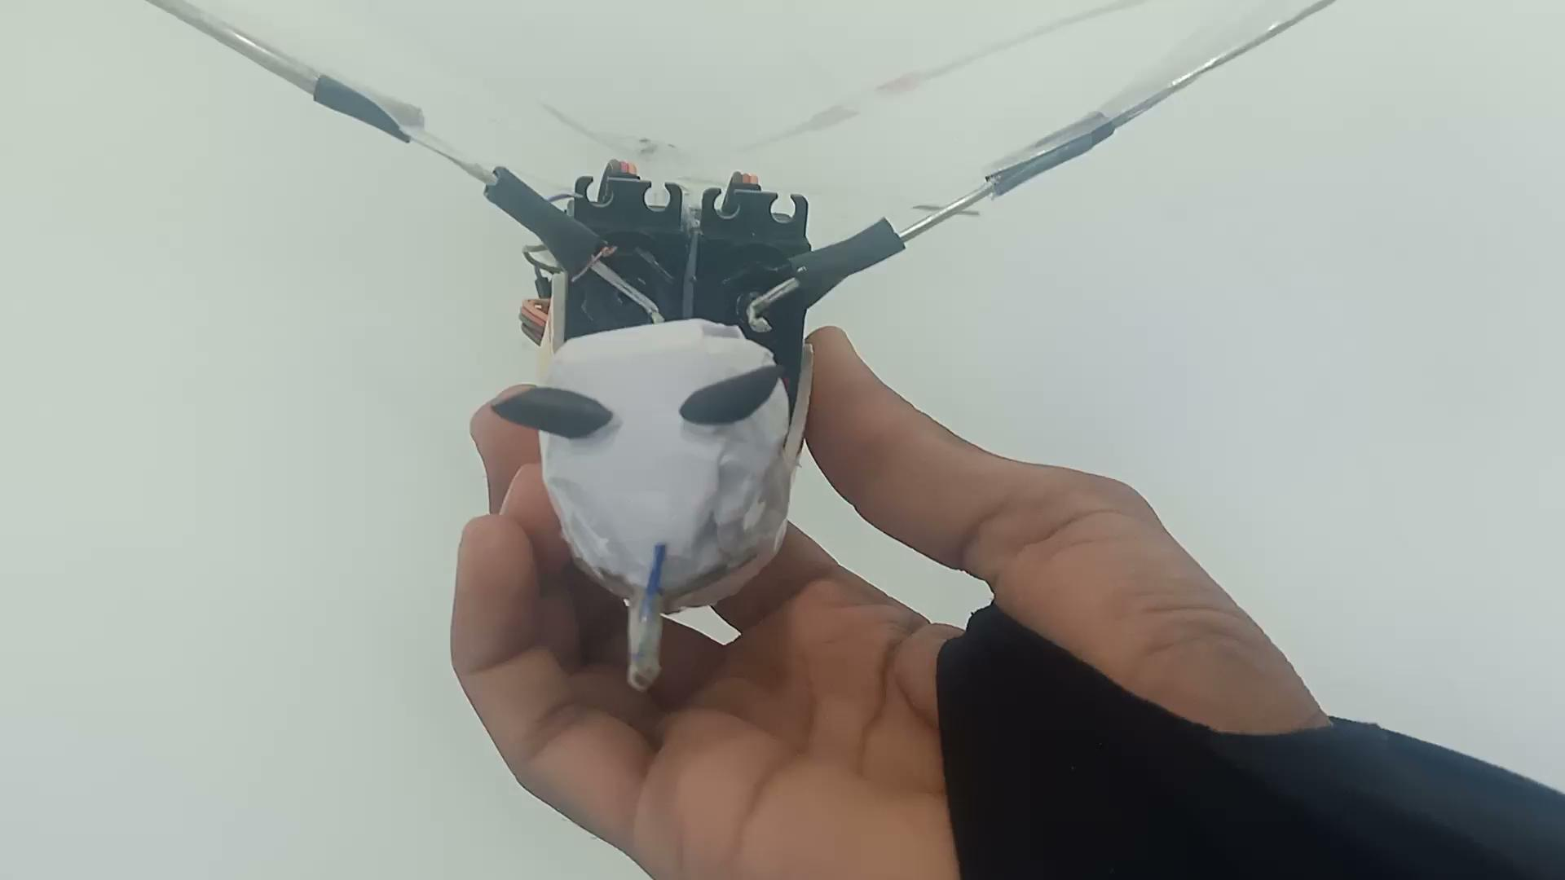
Project Video:-

Slide 18
Team Members
Himanshu Galav 2021EEB1177
Jigyasa Singh 2021EEB1182
Lokesh Jassal 2021EEB1185
Rajan Singh 2021EEB1201
Ritika Dashore 2021EEB1206
Shreya Maheshwari 2021EEB1212

Slide 19
THANK YOU

